Slide 1
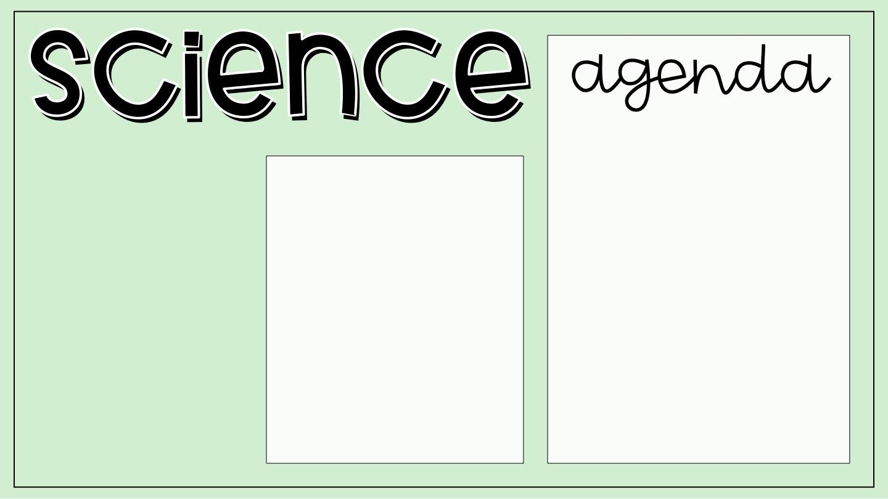
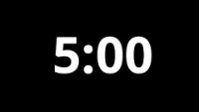
Welcome Back!
Biology Investigation 2: Poster Assignment/Validation Follow Up
Topic Test Revision Progress Map Task:
Requires access to Stile and a copy of the ‘Revision Progress Map’
Kahoot: Ecology Review
Can you reign supreme?
Learning Intention
We are reviewing Ecology for our Topic Test
Success Criteria
Materials
Identify gaps in own knowledge for our Ecology unit
Utilise resources to help me revise
Your Folder

Slide 2
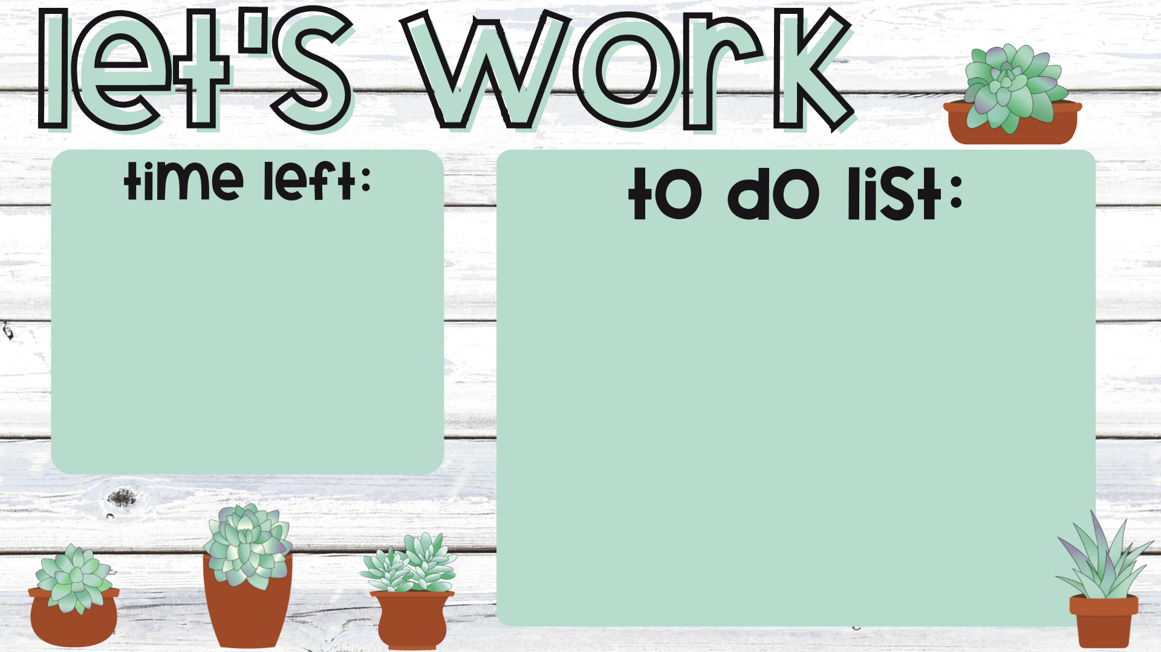
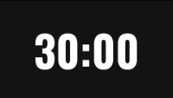
Complete an Ecology Review Quiz on Stile
Click the ‘Hand in for Marking’ button when you have finished
Put your hand up and ask Mr Forte to release your answers for the quiz
Write down your score and focus areas on the ‘Review Progress Map’ handout
Put your hand up to get Mr Forte to stamp your quiz
Move on to the next quiz to achieve all stamps

